Slide 1
Lecture 13
Optimal Binary Search Tree

Slide 2
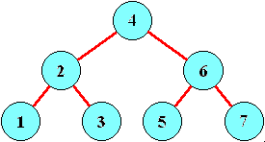
Binary Search Tree
Binary Search Tree is a node-based binary tree data structure which has the following properties:
The left sub-tree of a node contains only nodes with keys lesser than the node’s key.
The right sub-tree of a node contains only nodes with keys greater than the node’s key.
The left and right sub-tree each must also be a binary search tree.

Slide 3
Binary Search Tree
Possible BST for key values: 3, 7, 9, 12
For n keys,
The no. of binary trees possible=
2*nC_{n}
n+1

Slide 4
Cost of searching
When we know the frequency of searching each one of the keys, it is quite easy to compute the expected cost of accessing each node in the tree.
For example: Input: keys[] = {10, 12}, freq[] = {34, 50}. There can be following two possible BSTs
10 12
12 10
The cost of tree I is 34*1 + 50*2 = 134
The cost of tree II is 50*1 + 34*2 = 118
Tree I
Tree II

Slide 5
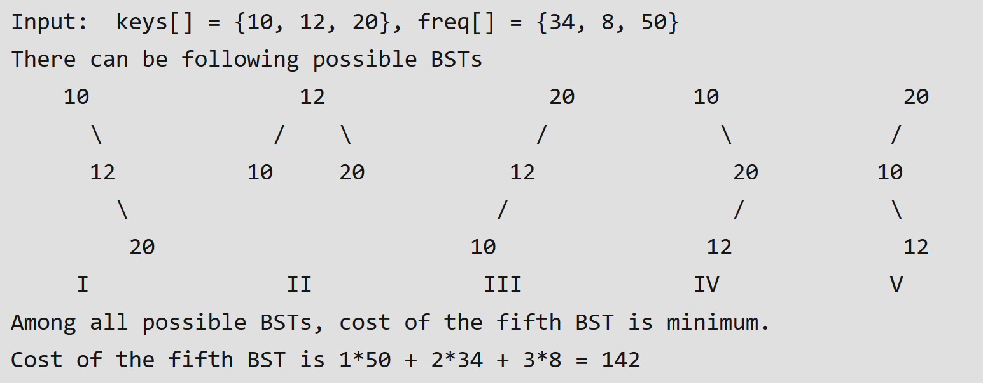
Cost of searching

Slide 6

Optimal Binary Search Tree
An optimal binary search tree is a binary search tree for which the nodes are arranged on levels such that the tree cost is minimum.
Binary search trees are used to organize a set of keys for fast access.
The tree maintains the keys in-order so that comparison with the query at any node either results in a match, or directs us to continue the search in left or right sub-tree.

Slide 7
Example
What is an optimal BST for keys A, B, C, and D with search probabilities 0.1, 0.2, 0.4, and 0.3, respectively?
Average number of comparisons
= 1*0.4 + 2*(0.2+0.3) + 3*0.1
= 1.7

Slide 8
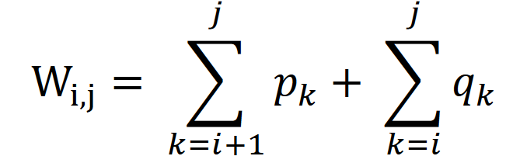
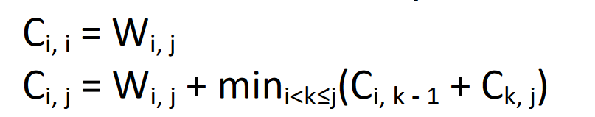
Dynamic Approach to OBST
OBST(i, j) denotes the optimal binary search tree containing the keys ki, ki+1, ..., kj.
W_{i, j} denotes the weight matrix for OBST(i, j)
W_{i, j} can be defined using the following formula:
C_{i, j}, 0 ≤ i ≤ j ≤ n denotes the cost matrix for OBST(i, j)
C_{i, j} can be defined recursively, in the following manner:

Slide 9
Dynamic Approach to OBST
R_{i, j}, 0 ≤ i ≤ j ≤ n denotes the root matrix for OBST(i, j)
Assigning the notation R_{i, j} to the value of k for which we obtain a minimum in the above relations, the optimal binary search tree is OBST(0, n) and each sub-tree OBST(i, j) has the root k_{Rij} and as sub-trees the trees denoted by OBST(i, k-1) and OBST(k, j).

Slide 10
Dynamic Approach to OBST
The bottom-up approach generates all the smallest required optimal sub-trees first, then all next smallest, and so on until the final solution involving all the weights is found.
Since the algorithm requires access to each sub-tree’s weighted path length, these weighted path lengths are stored in the weight matrix ‘W’.
Root of each sub-tree is stored for reference in the root matrix ‘R’.

Slide 11
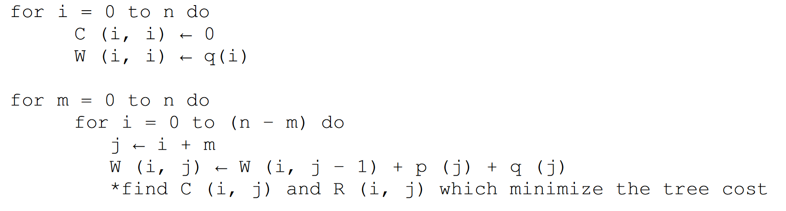
Algorithm: OBST
For determining R(i, j) and C(i, j) with 0 <= i <= j <= n:

Slide 12
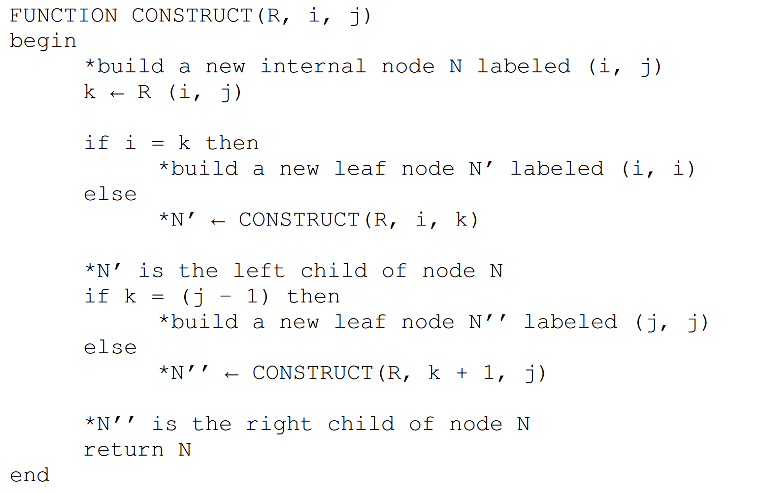
Algorithm: OBST
Following function builds an optimal binary search tree

Slide 13

Example: OBST
Find the optimal binary search tree for N = 6, having keys k1 ... k6 and weights
p₁ = 10, p₂ = 3, p₃ = 9, p₄ = 2, p₅ = 0, p₆ = 10
q₀ = 5, q₁ = 6, q₂ = 4, q₃= 4, q₄ = 3, q₅ = 8, q₆ = 0

Slide 14
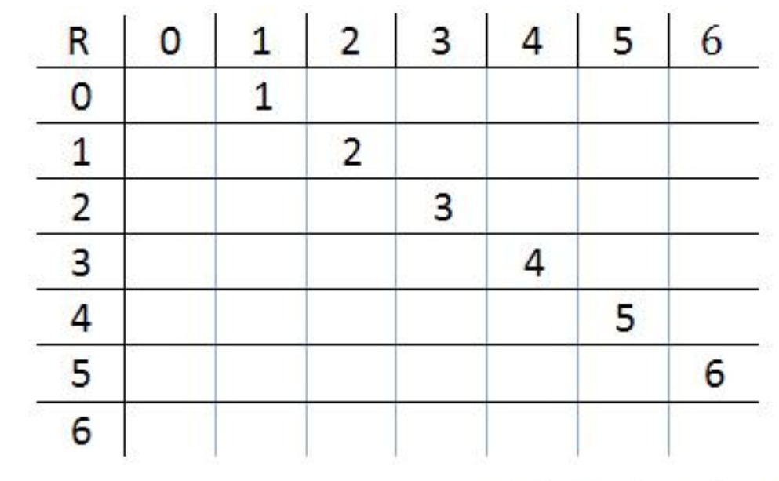
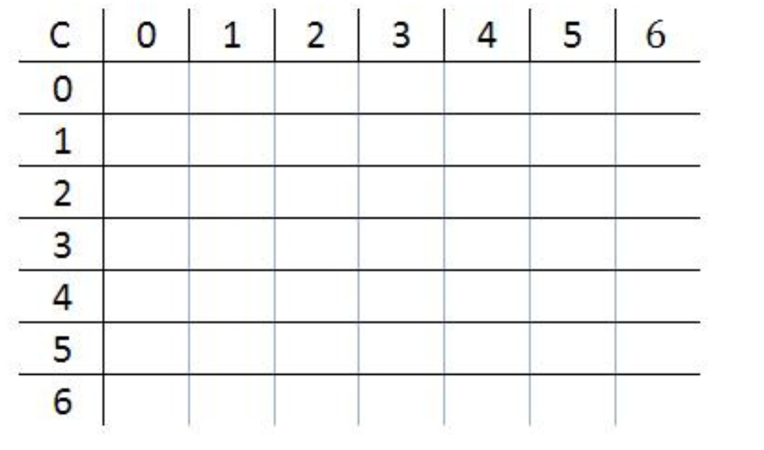
Solution
Initial arrays

Slide 15
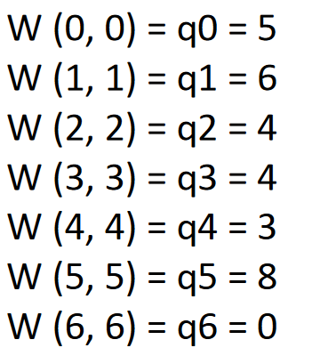
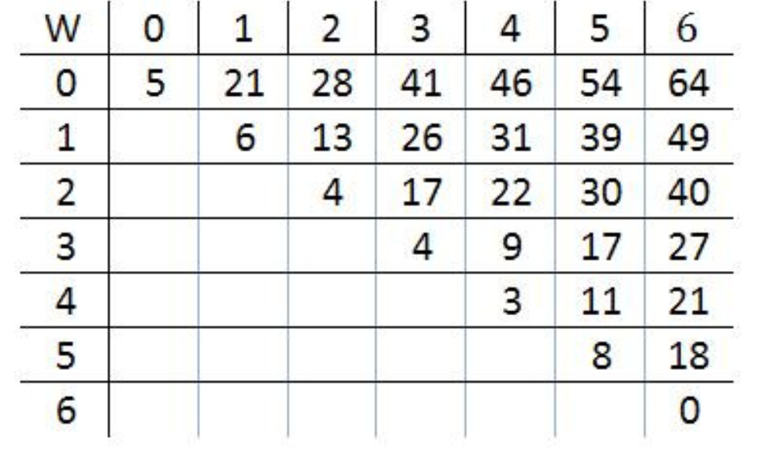
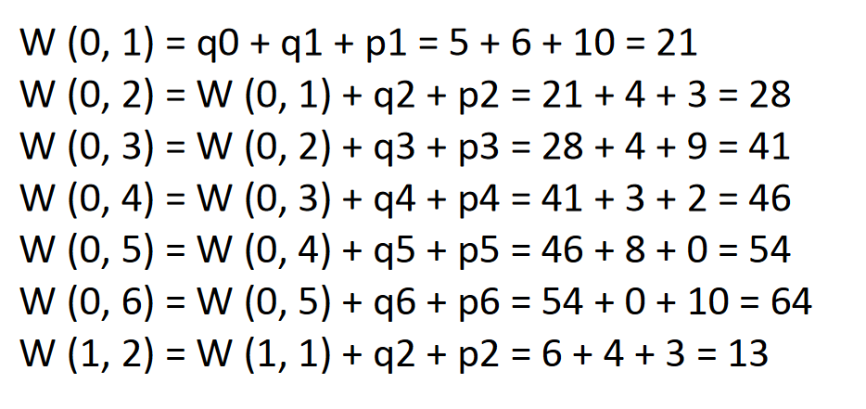
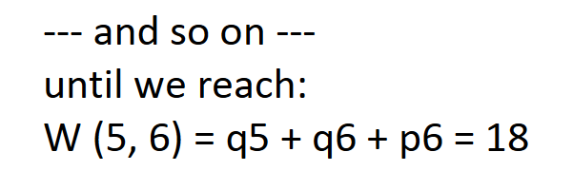
Solution

Slide 16
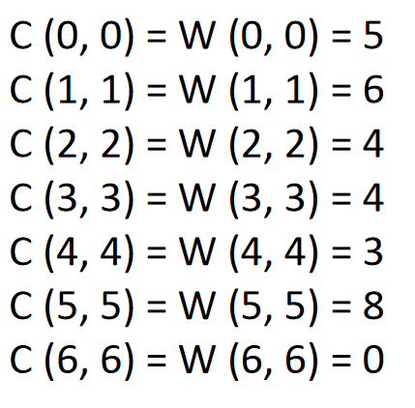

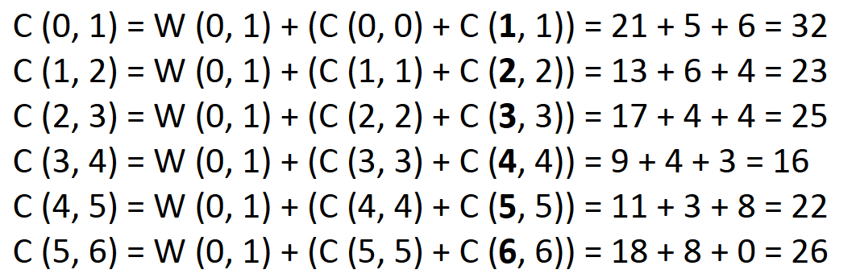
Solution

Slide 17
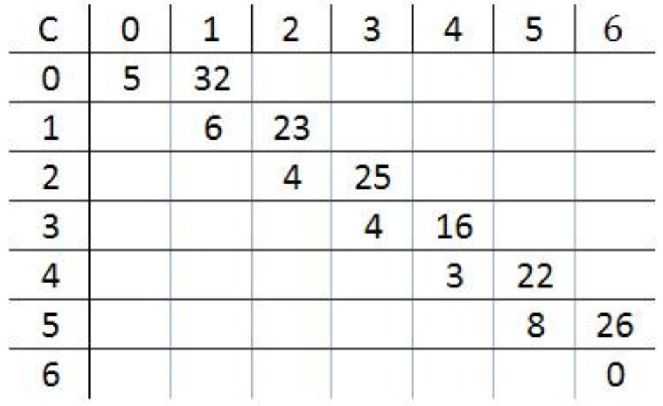
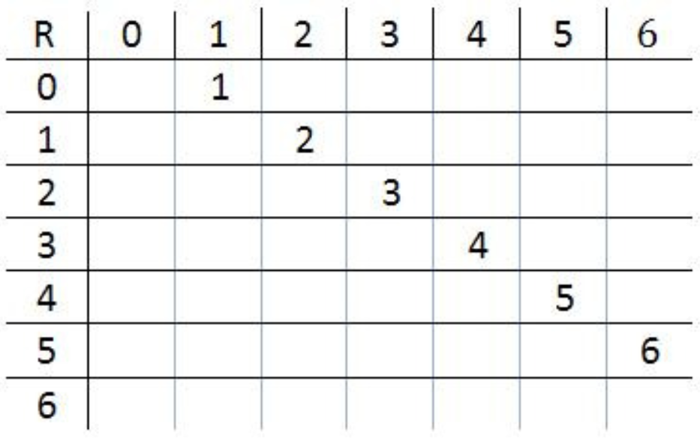
Solution
Substituting the values

Slide 18
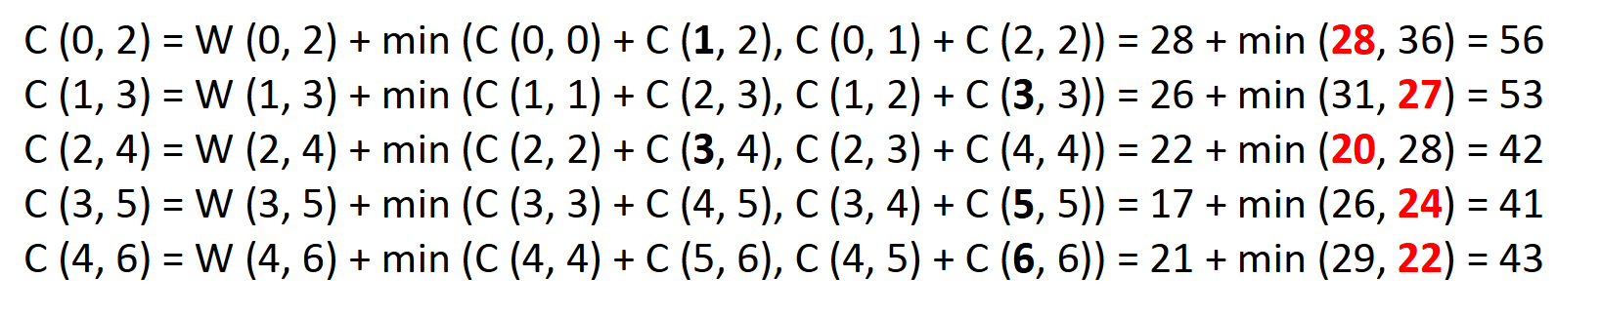
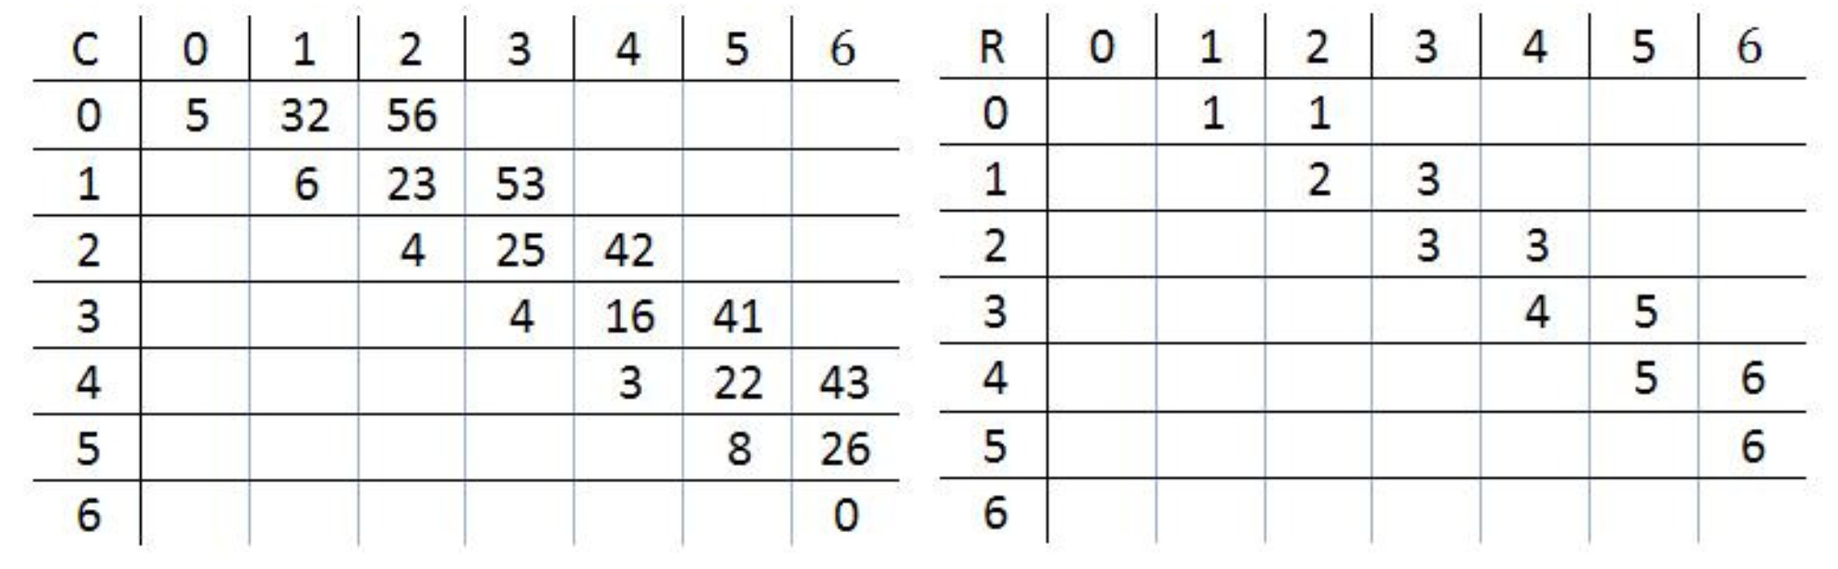
Solution

Slide 19
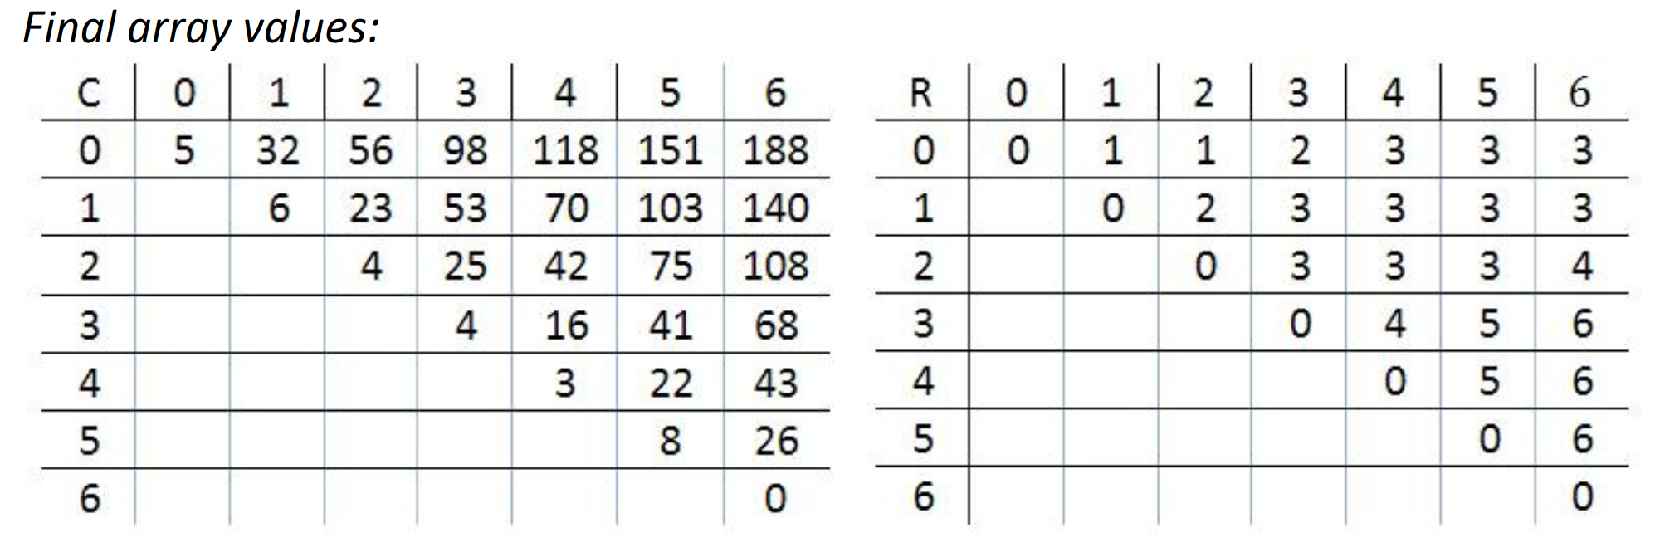
Solution

Slide 20

Solution
Computing the node positions in the tree:
-The root of the optimal tree is R(0, 6) = k3.
-The root of the left sub-tree is R(0, 2) = k1
-The root of the right sub-tree is R(3, 6) = k6
-The root of the right sub-tree of k1 is R(1, 2) = k2
-The root of the left sub-tree of k6 is R(3, 5) = k5
-The root of the left sub-tree of k5 is R(3, 4) = k4

Slide 21
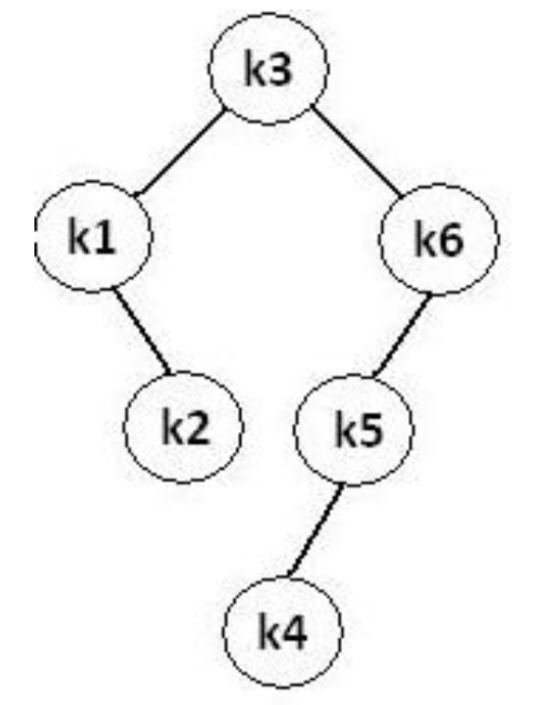
Solution
The resulting optimal tree is shown in the bellow figure and has a weighted path length of 188.

Slide 22

Complexity Analysis
The algorithm requires O (n²) time and O (n²) storage.
Therefore, as ‘n’ increases it will run out of storage even before it runs out of time.
The storage needed can be reduced by almost half by implementing the two-dimensional arrays as one-dimensional arrays.

Slide 23
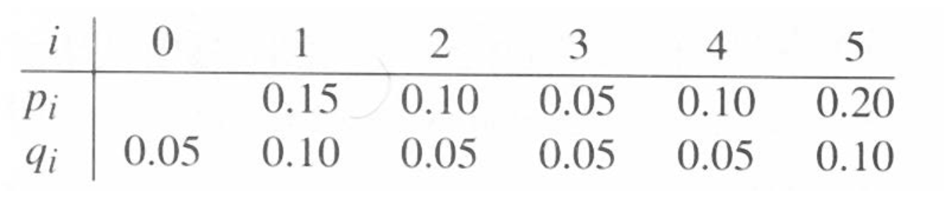
In class Practice
Ques: Construct OBST for the following values:

Slide 24
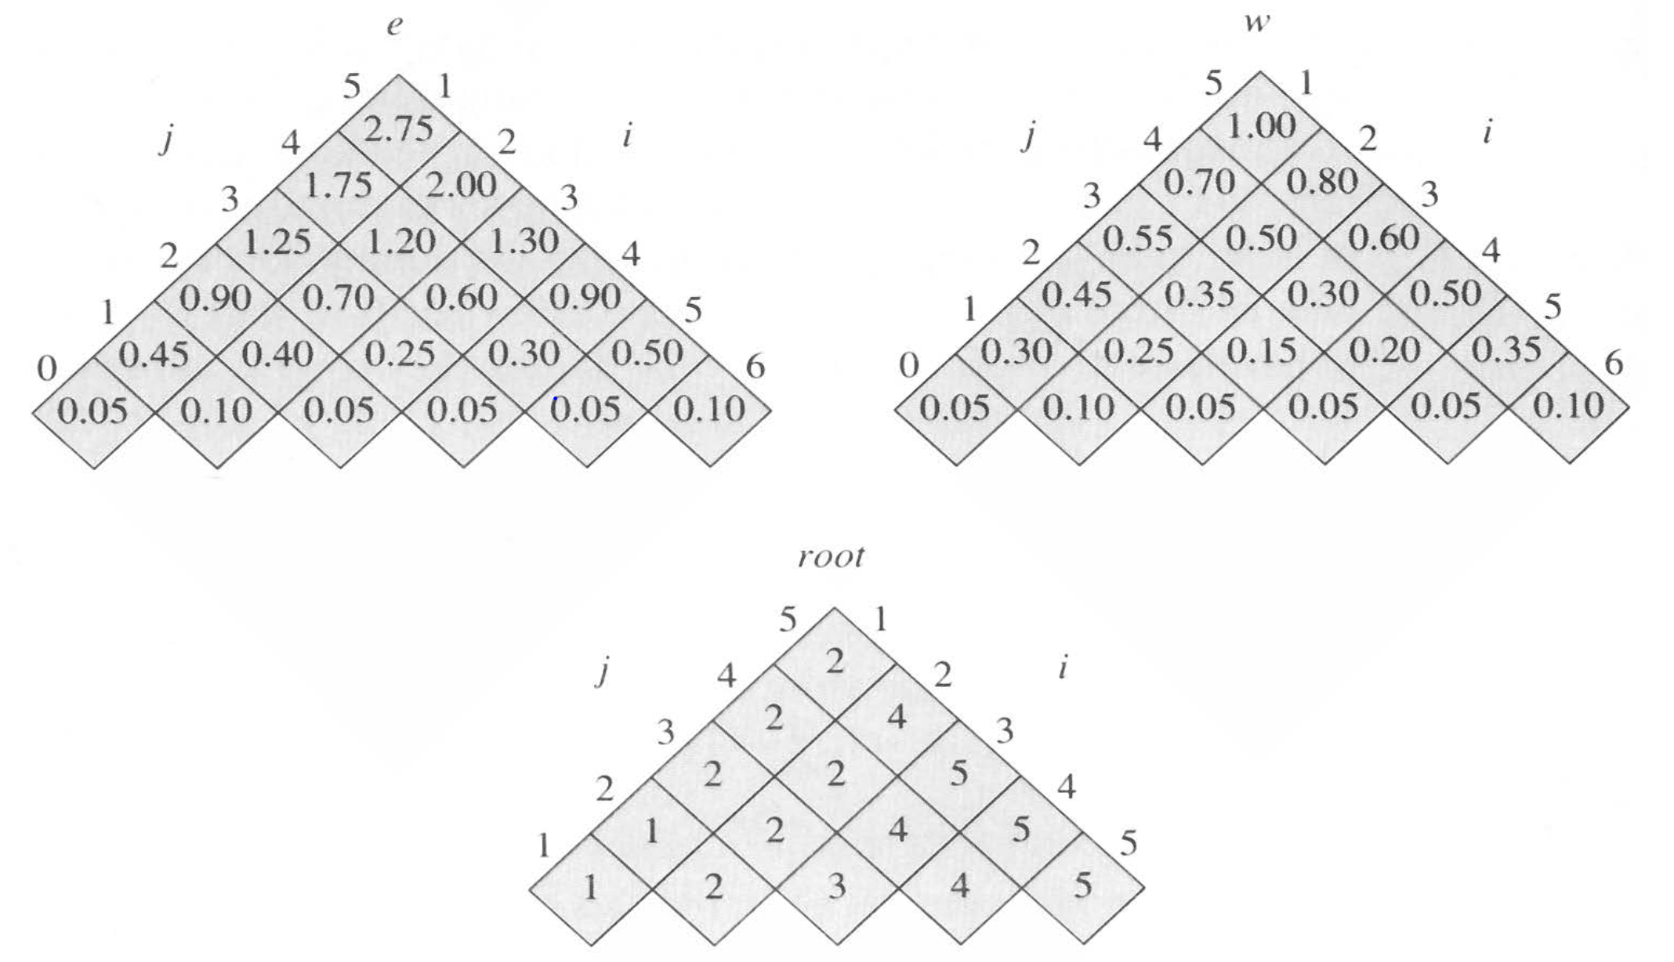
Solution

Slide 25
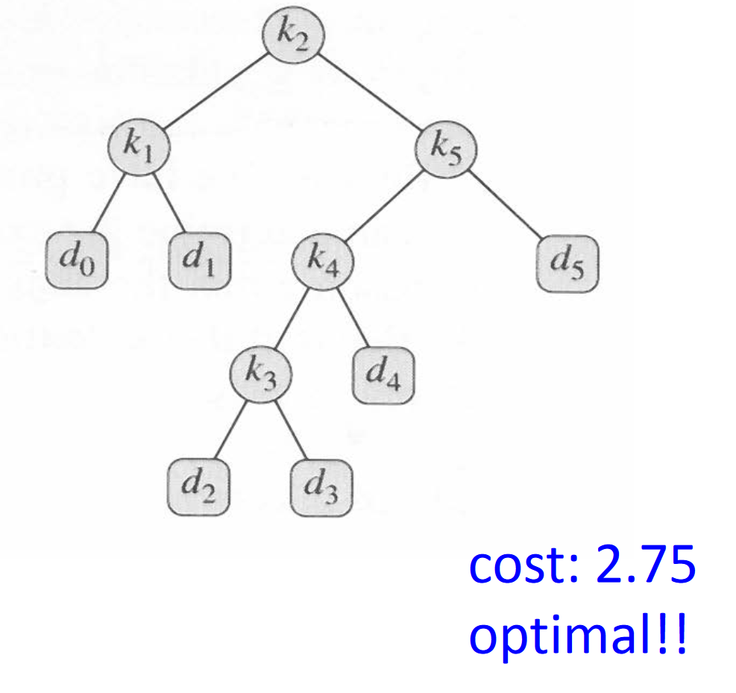
Solution

